Slide 7
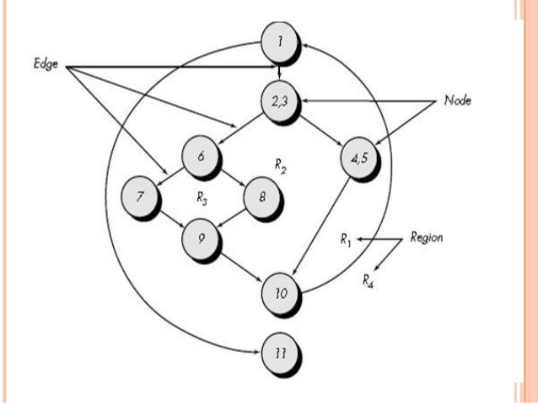

Slide 9
Cyclomatic Complexity
Cyclomatic complexity is a source code complexity measurement that is being correlated to a number of coding errors. It is calculated by developing a Control Flow Graph of the code that measures the number of linearly-independent paths through a program module.
Cyclomatic complexity = E - N + 2 or P+1
where,
E = number of edges in the flow graph.
N = number of nodes in the flow graph.
P = Number of predicate nodes (node that contains condition)

Slide 12
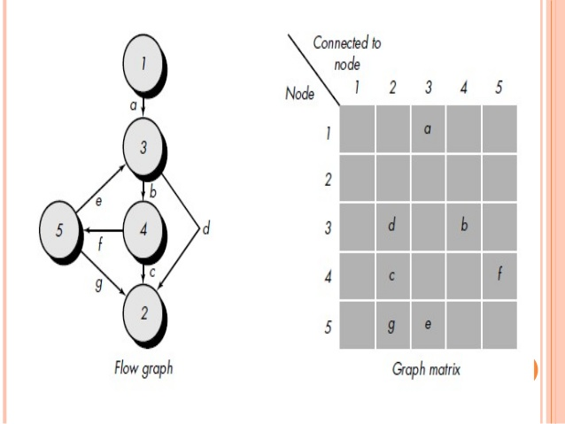

Slide 14
Steps for Basis Path testing
The basic steps involved in basis path testing:
Draw a control graph
Calculate Cyclomatic complexity
Find a basis set of paths
Generate test cases to exercise each path

Slide 15
Flow graph notation for a program:

Slide 16
Example 1:
IF A = 10 THEN
IF B > C THEN
A = B
ELSE
A = C
ENDIF
ENDIF
Print A
Print B
Print C

Slide 17
Cyclomatic complexity is 8 - 7 + 2 = 3 or 2+1=3

Slide 20
The common types of logical conditions that are tested using condition testing are-
A relation expression, like E1 op E2 where ‘E1’ and ‘E2’ are arithmetic expressions and ‘OP’ is an operator.
A simple condition like any relational expression preceded by a NOT (~) operator. For example, (~E1) where ‘E1’ is an arithmetic expression and ‘a’ denotes NOT operator.
A compound condition consists of two or more simple conditions, Boolean operator, and parenthesis. For example, (E1 & E2)|(E2 & E3) where E1, E2, E3 denote arithmetic expression and ‘&’ and ‘|’ denote AND or OR operators.
A Boolean expression consists of operands and a Boolean operator like ‘AND’, OR, NOT. For example, ‘A|B’ is a Boolean expression where ‘A’ and ‘B’ denote operands and | denotes OR operator.

